Slide 1
EMPLOYEE DATA ANALYSIS USING EXCEL
STUDENT NAME: ASHWINI R
REGISTER NO: 6DA580F7749D759B81F42D4FD53F3478,312208648
DEPARTMENT: B.COM (GENERAL)
COLLEGE: MEENAKSHI COLLEGE FOR WOMEN

Slide 2
PROJECT TITLE:
EMPLOYEE PERFORMANCE BASED ON JOB LEVEL AND WORK LIFE BALANCE ANALYSIS

Slide 3
AGENDA:
Introduction and Background
Problem Statement
Project Overview
End Users
Solution and Value Proposition
Dataset Description
Modeling Approach
The Wow Factor in Our Solution
Result - 1. Table 2. graph
Conclusion

Slide 4
PROBLEM STATEMENT:
Organizations often struggle to understand the relationship between employee performance, job level, and work-life balance. This lack of insight can lead to inefficiencies in resource allocation, employee dissatisfaction, and missed opportunities for improving performance. The problem is to identify and quantify how job levels and work-life balance affect employee performance, enabling organizations to make data-driven decisions to enhance productivity and satisfaction.

Slide 5
PROJECT OVERVIEW
This project aims to analyze the impact of job levels and work-life balance on employee performance using data-driven methods. By examining various factors such as job roles, working hours, job satisfaction, and performance metrics, we seek to uncover patterns and correlations that can inform better HR practices and organizational strategies.

Slide 6
WHO ARE THE END USERS?
HR Professionals: To optimize employee management and improve retention strategies.
Managers and Team Leaders: To tailor support and development programs based on employee needs.
Executives: For strategic decision-making regarding workforce planning and organizational structure.
Employees: Indirectly, to benefit from improved work-life balance initiatives and performance recognition.

Slide 7
SOLUTION AND VALUE PROPOSITION:
Solution:
We provide a comprehensive analytical framework that integrates data on job levels, work-life balance, and performance metrics. Our solution includes a set of actionable insights and recommendations based on this analysis
Value Proposition: By leveraging our solution, organizations can:
Better understand the dynamics between job levels, work-life balance, and performance.Implement targeted strategies to enhance employee satisfaction and productivity.Make informed decisions to optimize job roles and work conditions, leading to improved overall performance and lower turnover rates.

Slide 8
FILTERING – REMOVE VALUES
PIVOT TABLE – SUMMARY OF EMPLOYEE PERFORMANCE
GRAPH – FINAL PROJECT

Slide 9
DATA DESCRIPTION:
Employee data set: KAGGEL PROTRAL
Employee ID: A unique identifier assigned to each employee.
Age: The age of the employee, ranging from 18 to 60 years.
Gender: The gender of the employee
Years at Company: The number of years the employee has been working at the company.
Monthly Income: The monthly salary of the employee, in dollars.
Job Role: The department or role the employee works in, encoded into categories such as Finance, Healthcare, Technology, Education, and Media.
Work-Life Balance: The employee's perceived balance between work and personal life, (Poor, Below Average, Good, Excellent)

Slide 10
DATA DESCRIPTION:
Number of Promotions: The total number of promotions the employee has received.
Distance from Home: The distance between the employee's home and workplace, in miles.
Education Level: The highest education level attained by the employee: (High School, Associate Degree, Bachelor’s Degree, Master’s Degree, PhD)
Marital Status: The marital status of the employee: (Divorced, Married, Single)
Job Level: The job level of the employee: (Entry, Mid, Senior)
Company Size: The size of the company the employee works for: (Small,Medium,Large)
Company Tenure: The total number of years the employee has been working in the industry.
Remote Work: Whether the employee works remotely: (Yes or No)
Leadership Opportunities: Whether the employee has leadership opportunities: (Yes or No)

Slide 11
DATA SET DESCRIPTION:
Innovation Opportunities: Whether the employee has opportunities for innovation: (Yes or No)
Company Reputation: The employee's perception of the company's reputation: (Very Poor, Poor,Good, Excellent)
Employee Recognition: The level of recognition the employee receives:(Very Low, Low, Medium, High)

Slide 12
MODELLING:
STEP 1: download the employee dataset in KAGGEL PORTRAL and open the employee dataset in excel.
STEP 2: select the entire data and click on data and click on filter option.
STEP 3: filter fip from A to Z order.
STEP 4: select the entire data and click on imsert and click on pivot table to create pivot table
STEP 5: drag the needed data and create a pivot table.
STEP 6: select the pivot table and click on insert
STEP 7: now click on the chart that you want.
STEP 8: the chart is created.

Slide 13
THE WOW FACTOR IN OUR SOLUTION:
The wow factor of our solution lies in its ability to provide a nuanced analysis that connects job level and work-life balance to performance in a holistic manner. Our advanced data visualization tools and predictive analytics enable users to see real-time impacts and trends, allowing for proactive management and personalized employee development strategies.

Slide 14
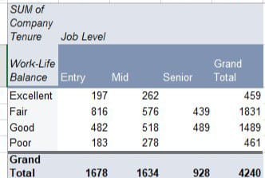
RESULT : 1. TABLE

Slide 15
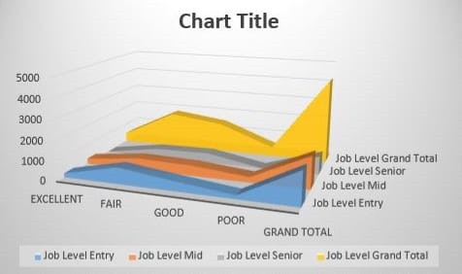
2. BAR DIAGRAM

Slide 16
CONCLUTION:
The project provides valuable insights into how job level and work-life balance impact employee performance. By applying rigorous data analysis techniques, we have identified key relationships and patterns that can guide organizational strategies. The insights gained from this project enable better decision-making, improve employee satisfaction, and ultimately enhance overall performance and productivity within the organization.

